Slide 1
Chapter 12 Beyond Bag of Words

Slide 2
Objectives
Idea of Feature-Based Retrieval Models
What are Term Dependence Models?
Search for Words, Pictures, and Music

Slide 3
Contents
12.1 Feature-Based Retrieval Models
12.2 Term Dependence Models
12.3 Structure Revisited
12.4 Longer Questions, Better Answers
12.5 Words, Pictures, and Music
12.6 One Search Fits All?

Slide 4


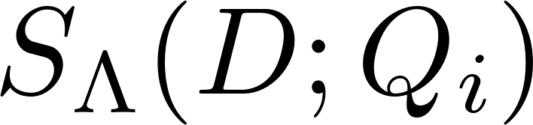


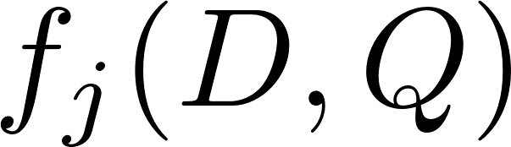
12.1 Feature-Based Retrieval Models
For a set of documents D and a set of queries Q, we can defne a scoring or ranking function parameterized by Λ, which is a vector of parameters. Given a query , the scoring function is computed for each D ∈
where is a feature function that maps query/document pairs to real values, and Z is a constant that does not depend on D (but may depend on Λ or Q)

Slide 5




12.1 Feature-Based Retrieval Models
The goal of a linear feature-based retrieval model is to fnd a parameter setting Λ that maximizes the evaluation metric E for the training data
where are the rankings produced by the linear scoring function

Slide 6
12.1 Feature-Based Retrieval Models
Arelatively small number of features have been used as the basis of the retrieval models
Term occurrence
Term frequency
Inverse document frequency
Document length
Term proximity
Notes:
• Term occurrence: whether or not a term occurs within a document • Term fequency: number of times a term occurs within a document • Inverse document fequency: inverse of the proportion of documents that contain a given term • Document length: number of terms in a document • Term proximity: occurrence patterns of terms within a document (the most common way of incorporating term dependency)

Slide 7
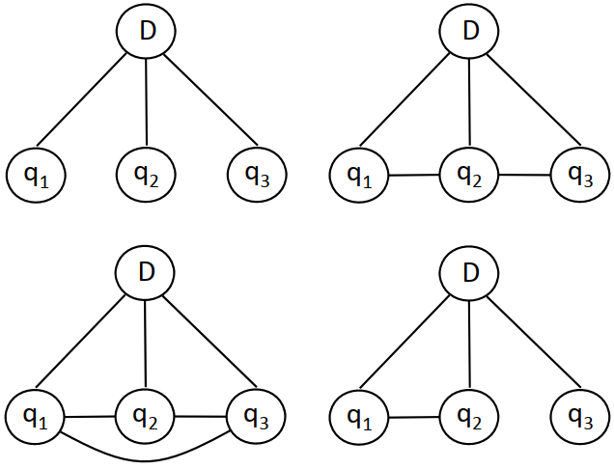
12.2 Term Dependence Models
Retrieval models that make use of term relationships are ofen called term dependence models
They do not assume that words occur independently of each other
Markov Random Field
Full independence
Sequential dependence
Full dependence
General dependence

Slide 8
12.3 Structure Revisited
Exploiting document structure is a critical part of web search, and combining different sources of evidence effectively is an important part of many database applications

Slide 9
12.3 Structure Revisited: XML Retrieval
XML is an important standard for both exchanging data between applications and encoding documents
Content-and-structure (CAS) query: contain a description of a topic and explicit references to the XML structure
//article[.//fm/yr < 2000]//sec[about(.,”search engines”)] - find articles published before 2000 (fm is the front matter of the article) that contain sections discussing the topic “search engines”.
//article[.//fm/yr < 2000]//sec[about(.,”search engines”)] - find articles published before 2000 (fm is the front matter of the article) that contain sections discussing the topic “search engines”.
Structure is an important part of defining features for effective ranking

Slide 10
12.3 Structure Revisited: Entity Search
Information extraction techniques that can be used to identify entities in text such as people, organizations, and locations
Entity search uses this structure to provide a ranked list of entities in response to a query instead of a list of documents
The simplest approach to building these representations is to create “pseudo-documents” by accumulating all words that occur within a specified text window (e.g., 20 words) for each occurrence of an entity
Notes:
if the organization entity “california institute of technology” occurred 65 times in a corpus, every word within 20 words of those 65 occurrences would be accumulated into the pseudo-document representation.

Slide 11
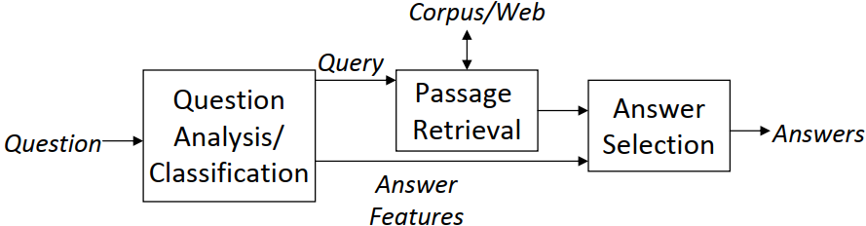
12.4 Longer Questions, Better Answers
The task of question answering involves providing a specific answer to a user’s query
Information derived from question analysis and classification is used by the answer selection component to identify answers in candidate text passages, which are usually sentences.
Notes:
rather than a ranked list of documents
Question answering system architecture

Slide 12
12.5 Words, Pictures, and Music
Information retrieval has traditionally focused on text. But only text?
Others: images, videos, or audio
Search for images, videos, or audio: text-based services, relying on titles, captions, user-supplied “tags,” and other related text to create representations of non-text media for searching
Text may not capture important aspects of the object being represented
Optical character recognition (OCR), Speech recognition technology
Notes:
Many of the videos stored at video-sharing sites do not have good textual descriptions, for example, and because there are so many of them, user tags do not solve this problem

Slide 13
12.6 One Search Fits All?
There are a variety of different search services, rather than a single search engine with more and more capability
Researchers from information retrieval and related fields, such as machine learning and natural language processing, have developed similar approaches to representing text and modeling the process of retrieval

Slide 14
Summary
Feature-Based Retrieval Models
Term Dependence Models
Structure Revisited: XML Retrieval, Entity Search
Search for Words, Pictures, and Music

